Slide 1

Strategic Leadership & Management Capstone: Coursera
MBA_590_1_SP23_106
Notes:
Good afternoon, everyone and thank you for having us.
So, this is our plan for Coursera to increase your revenue by at least 4 %.

Slide 2
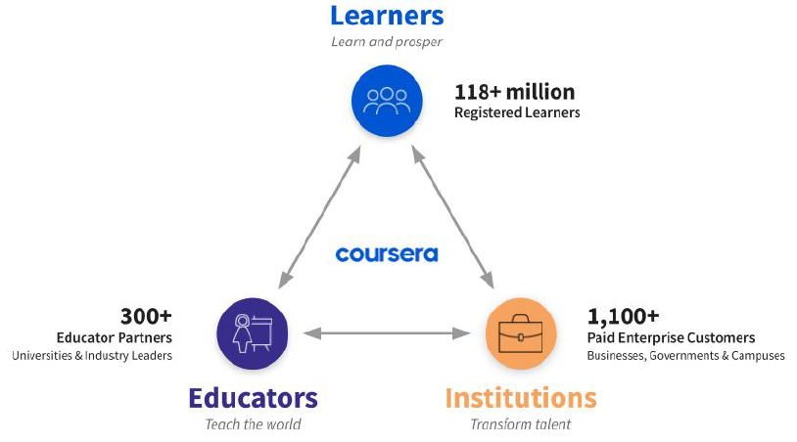
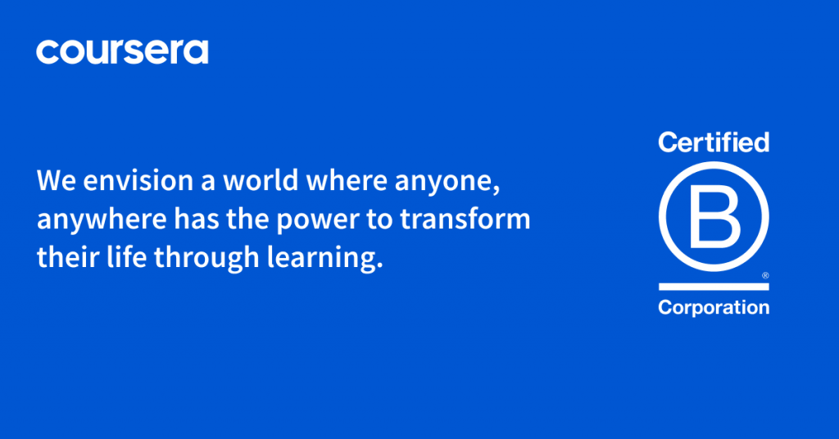
Introduction
Coursera is a global platform for online learning and career development
that enables a global ecosystem of educators, learners, organizations, and institutions.
Coursera’s Global Learning Ecosystem as of December 31, 2022
Coursera Receives B Corp™ Certification
Notes:
As you already know, Coursera is a global platform for online learning and career development.
During the COVID-19 pandemic, Coursera played great role in empowering communities and institutions with this global learning ecosystem.
As a result, Coursera received B Corp Certification from B Lab in Feb 2021.
I will pass to Jason for the pain point part.

Slide 3






Current Pain Points
Market saturation in the higher education space
Turning more members into paid users
Reaching a larger audience than just the English speaking world.
Low completion rate

Slide 4
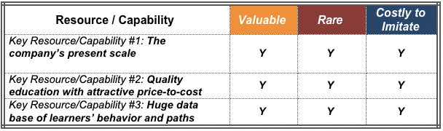
What does Coursera do best?
Coursera by Numbers:
118+ million registered learners;
1100 businesses, a quarter of which is Fortune 500 companies like Amazon, Google and 100 government agencies and organizations around the world;
partnering over 300 prestigious universities and industry partners;
its average student acquisition cost is less than $2,000 which is lower than industry standard.
Notes:
Now lets look at what Coursera does best.
First, being in the leader in the market, it has the scale competitive advantage with a huge number of registered learners plus the partnerships with thousands of businesses, government agencies and top universities.
Another advantage that coursera has is the attractive price to cost offerings ranging from free courses to paid certifications to fully accredited education programs like iMBA
Lastly, building on the huge database of learners, coursera knows learners behaviors. It can then use technology to help build optimal learning programs based on learners needs.
I'm going to pass it to Dom to talk about SWOT analysis

Slide 5
SWOT analysis
Strengths
Weaknesses
Global & Digitalized
Network of leading academic and industry partners
Recognizable Brand
Technological & Innovation breakthrough
Adaptable
Digital/Virtual learning vs Real-life
Students > Educators : leading to peer-grading system
Plagiarism potential
Currently US-centric
Academia > Thought-building
Opportunities
Threats
Availing equal educational opportunities
Beyond Enterprises/ Universities/ Governments
Expanding vertical & horizontally
Across global education systems
Younger generation embrace tech
Economic recession
Lack of Recognition
Competition
Dilution of qualification
Replaceable by Artificial Intelligence
Coursera – a transformative platform capable of delivering quality education globally ensuring education equality regardless of demographics in a nevertheless constantly changing environment
Notes:
Presenting the SWOT analysis segment for Coursera.
For its strength, it is a fully digitalized platform capable of attracting its already prestigious network of institutions and partners. Given its reputation for innovative delivery using technology, it can replicate its already successful model and expanding beyond.
Its identified weakness includes the perceived advantage of real-life learning, the lack of interaction, with peer grading at times leading to sub-optimal results. Catering to higher-learning age groups, predominantly a US-centric provider, it may limit its scope, isolating other geographies and demographics. All of which may have led to failure for paid certification conversion.
With opportunities, there is further potential to expand both laterally and vertically across age groups, and beyond current targeted segments. With a growing emphasis globally in K-12 education, and in a generation embracing tech, Coursera can optimize its potential by providing global access to seamless education-of-choice.
With threats, available competition, introduction of AI and perceived dilution of recognition of its certification. Over to you Shaun.
.

Slide 6
Growth initiative for Coursera
Competitor Comparison
K-12 Education
 | Coursera | Chegg
Net Revenue | 573 Million | 767 Million
Net Profit (Loss) | -175 Million | 266 Million
K12 Education $103 billion
10% K12 Online Edu $ 10 billion
2% target market size $200 million
Opportunity Size:
$200 Million
Low cost by technology advantage
Many established online competitors
Lower quality comparing to offline competitors
Benefits
Larger Customer Base
Risks
Notes:
Our recommendation is for Coursera to expand its offerings to include K-12 education.
Here, we can see that although the competitor Chegg is generating similar revenue to Coursera, it is making a significant profit instead of experiencing a loss. This highlights the potential profitability of entering the K-12 education market for Coursera.
The 2021 market size for K-12 education is estimated to be around 100 billion, and assuming that the online part represents 10% of this total, it is worth around 10 billion. If Coursera can capture just 2% of this target market, it could generate around 200 million in profit, which represents a growth of approximately 40%.
With its established branding, Coursera has the potential to expand into the K-12 education market and capture the 200 million opportunity size. This move could benefit Coursera by providing access to a much larger customer base, as young people at this stage typically prioritize education.
Additionally, leveraging their existing technology could significantly lower costs compared to offline K-12 education.
However, it's important to note that there are already established players in the market such as Khan Academy or Duolingo. Moreover, competing in terms of quality with offline competitors like VIPKIDS or New Oriental could be challenging, particularly considering the rise of online products since the pandemic.
Over to Paula.

Slide 7
Growth Plans
Direct Learners
Enterprise (Businesses, government, etc.)
Degrees (Universities)
US Data: National Center for Education Statistics, 2020-21
49.5M
Core Business:
ONLINE Education offered by professionals from top institutions
Who:
Global
Top 3: US, India, Mexico
Aggressive expansion: MENA, LATAM
19.4M
Where:
What:
Wide range of Mass Open Online Courses (MOOCs) mainly catering to > 18 year old learners
Current target : Post Secondary learners
V
R
I
Stackable degree accreditation
Access to higher education, anytime, anywhere
Educators from Top institutions
Pre-K to G12 students

Slide 8
Growth Plans
Direct Learners
Enterprise (Businesses, government, etc.)
Degrees (Universities)
US Data: National Center for Education Statistics, 2020-21
49.5M
Who:
Core Business:
ONLINE Education offered by professionals from top institutions
Platform for new content catering to K-12 learners in the US and abroad → LANGUAGE, etc.
Global
Top 3: US, India, Mexico
Aggressive expansion: MENA, LATAM
19.4M
Where:
Enhance access and increase learner – educator interface → Interactive apps (M&A: eg. Duolingo)
What:
Wide range of Mass Open Online Courses (MOOCs) mainly catering to > 18 year old learners
AI Development: to include real-time validation including grammar check, speaking/pronunciation, etc.
Current target: Post Secondary learners
V
R
I
Pre-K to G12 students
Access to higher education, anytime, anywhere
Educators from Top institutions
Stackable degree accreditation

Slide 9
Future of online education
Maybe 2 to 3 mins - what company is, some info about the company, key strengths, key challenges, 1 min - future of the industry (part 4) / industry outlook, 2-3mins - 2 to 3 growth initiatives

Slide 10
Thank you
MBA_590_1_SP23_106

